Slide 1
Agile and JIRA
Sarower Ahmmed

Slide 2


Slide 3
My Need?
To Buy a house
Its called concept or need in IT world

Slide 4


Your dream house?

Slide 5
Dream house Criteria in detail- Requirement
………
…….........
…………………..
………………………
……………………………..
……………………………………………………..
…………………………………………………………….
………………………………………………………………………

Slide 6


Slide 7
You should need some ability to buy dream house
Financial ability
……………….
………………………..
…………………………….
………………………………………

Slide 8
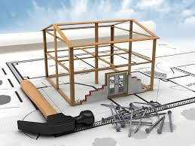
If you want custom build house: Need Design from architecture /design team

Slide 9

Need a team of construction worker to build Dream house

Slide 10
If you buy ready house :: like
3rd party application or software
No need own design team
No need development

Slide 11
When development done or before buy: need to check as it fulfill your requirement- Testing

Slide 12
Repaired and maintenance your dream house if required

Slide 13


Slide 14


Slide 15



Slide 16
SDLC SDLC: Software Development Life Cycle is a standard process used by software industry to design, develop and test high quality of software.
Stages:
Concept
Requirement
System design
Coding/ Development
Testing
Implementation & maintenance
PAPER BASED
HANDS
ON

Slide 17
QA responsibility in SDLC
Responsibility | Stages
No active involvement, But can Participate on meetings, | Concept
Read requirement document try to understand as requirement : Clear, Consistence and Testable | Requirement
Read design document, Writing test cases based on design prototype of application | Design Stage
Black box tester not active but White box tester do unit testing. | Development Stage
All testing need to do in this stage with manage Defect Life cycle | Testing Stage
Do regression test if any update version or defect fix | Implementation & Maintenance

Slide 18
STLC stages: SDLC stages
Req analysis
Test process
Test plan
Test case
Test data
RTM
Executed
Defect manage
Test reporting
Concept
Req
System design
Code/ Development
Testing
Implementation & maintenance
On PAPER
Pass
Fail

Slide 19
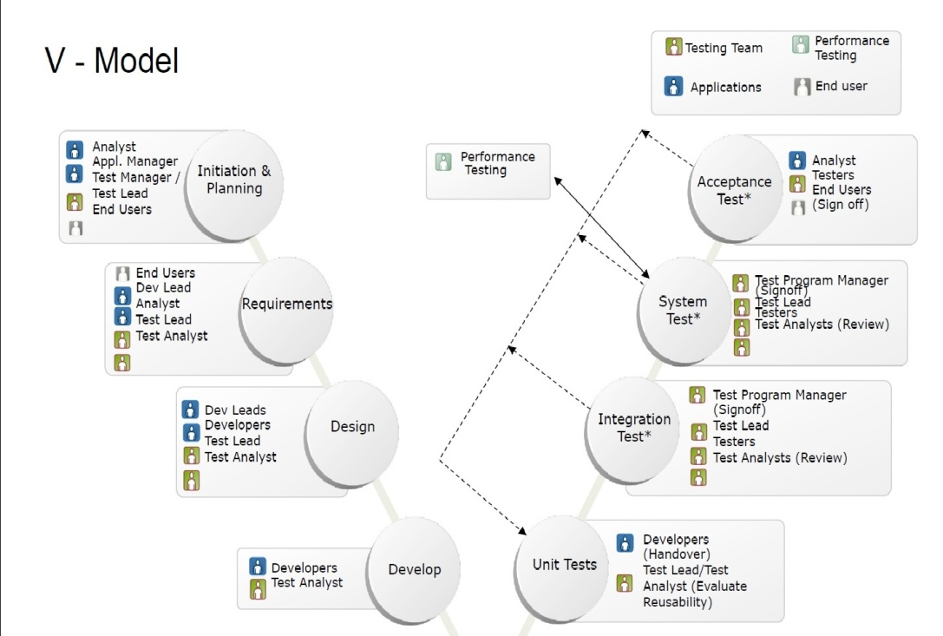
V model:
Two things:
Lt side > verification. Rt side > validation

Slide 20
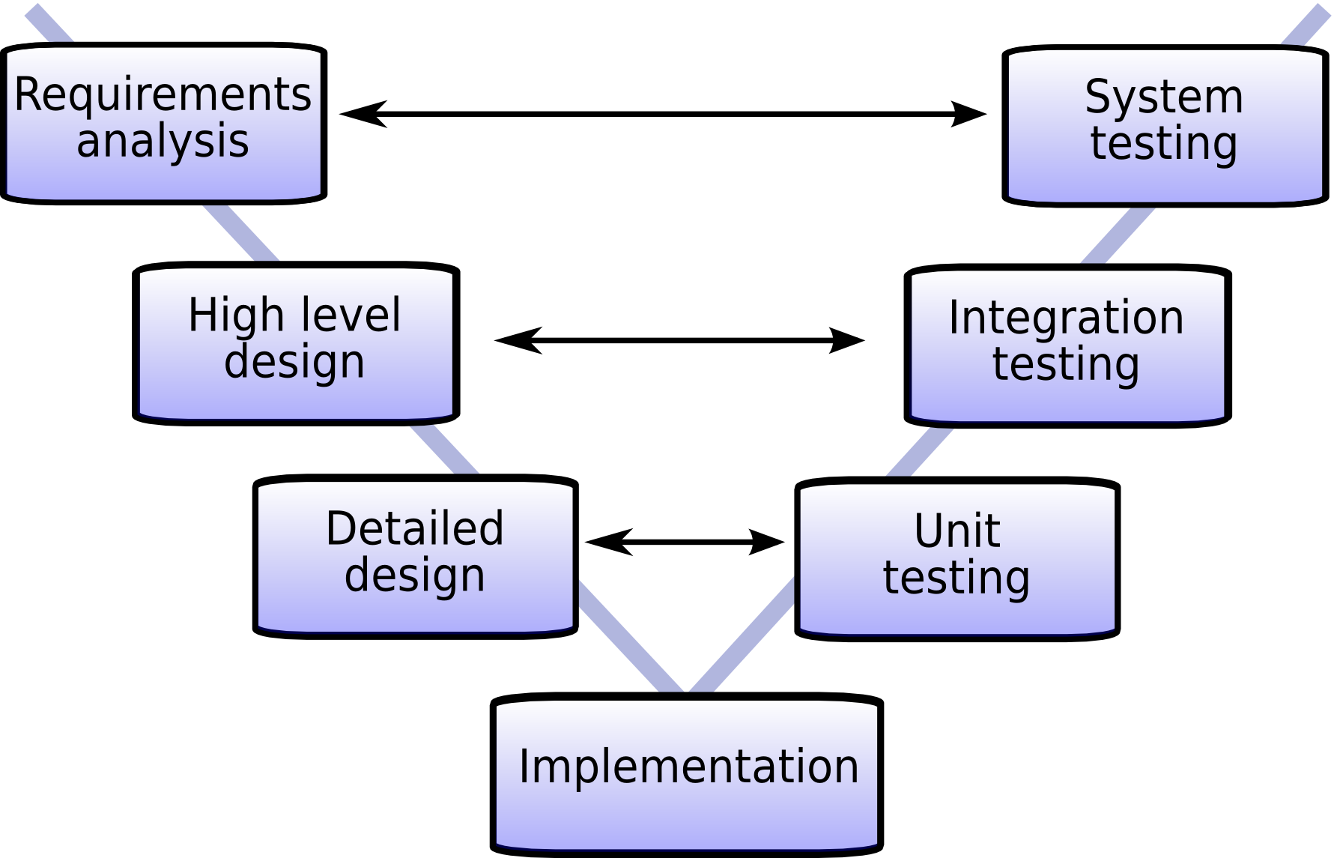

Slide 21
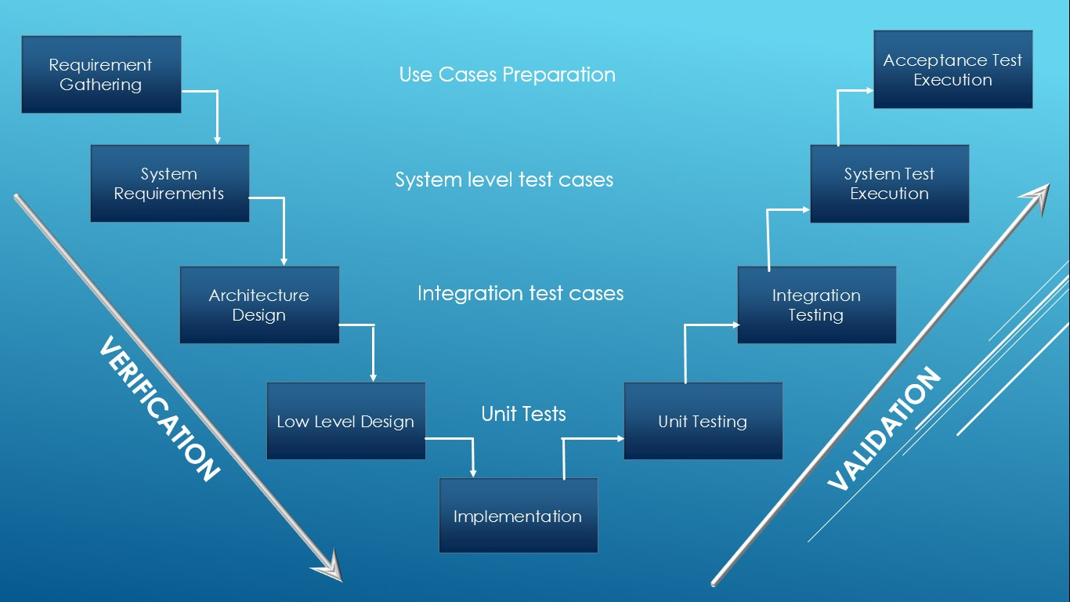

Slide 22
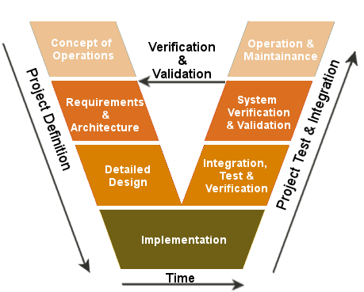

Slide 23
Methodology:
A standard/guideline how to follow the stages.
Types:
Waterfall
Iterative
Agile
Purpose:
Faster
Better
Cheaper

Slide 24
Methodology
Waterfall
6 to 12 ms
Govt. org
Iterative
Always change req
Agile
3 ms
Real time communication
FASTEST
2 wks

Slide 25
Waterfall
The oldest.
Must be sequential-Waterfall Model is a flow based model, in which we pass every phase once, and can not go back to that phase again.
Type:
Flexible waterfall: requirement system design.
Stick waterfall-
Can’t go back and front,
Can’t change the requirement.
Disadvantage:
Long wait time> 6 to 12 months=> private comp not use.
Advantage: If we know what customer requirement>then its best to use.

Slide 26
Iterative
Build a system with increment.
We can changes the requirement-we can always come back to previous phases, and make the changes accordingly.
Example:
Supposed we have 400 requirements
Waterfall=>> all 400 will be done in 1 yr
Here:
400
100
100
100
100
All stages
3 months
All stages
3 months
All stages
3 months
All stages
3 months

Slide 27
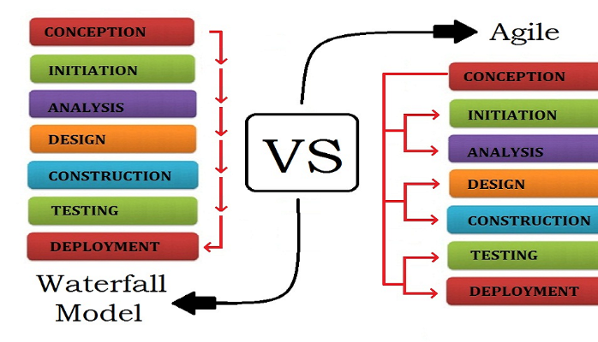

Slide 28
Agile Methodology:
AGILE is a methodology that promotes continuous increment of development and testing throughout the software development life cycle process.
Mostly used.
More automic but its a similar type of Iterative
It can deliver within 2 wks to 4 wks =>> So its FASTER
Handle less number of requirements.
Real-time communication:
Less documents
1 developer for 1 tester for 1 business analysis

Slide 29
Scrum calls for four ceremonies that bring structure to each sprint:
Sprint planning: A team planning meeting that determines what to complete in the coming sprint.
Daily stand-up: Also known as a daily scrum, a 15-minute mini-meeting for the software team to sync.
Pre Planning (Backlog/sprint Grooming): When: Mid sprint
everyone helps prepare the scrum backlog for the sprint planning meeting. This usually includes adding new stories and epics, extracting stories from existing epics, and estimating effort( t-shirt sizing) for existing stories.
Sprint retrospective: A review of what did and didn't go well with actions to make the next sprint better.

Slide 30
Daily Scrum Meeting:
Called Daily Standup meeting
Scrum meeting held every day and always 3 Qs and time 10 to 15 mints:
What did u do yesterday?
What will u do today?
Any major issue that requires escalation?

Slide 31
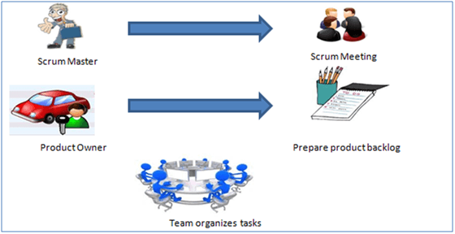
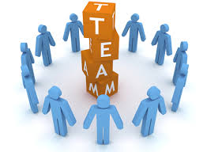

Slide 32
Three essential roles for scrum success
The product owner:
Build and manage the product backlog
Closely partner with the business and the team to ensure everyone understands the work items in the product backlog
Give the team clear guidance on which features to deliver next
Decide when to ship the product with the predisposition towards more frequent delivery

Slide 33
The scrum master
Head of Sprint
Deeply understands the work being done by the team and can help the team optimize their delivery flow.
As the facilitator-in-chief, they schedule the needed resources (both human and logistical) for sprint planning, stand-up, sprint review, and the sprint retrospective.

Slide 34

The scrum team
Dev: Tester= 2:1
Manager
Lead
Automation Tester
Manual Tester
Developer
Tester
Agile Team Members
Scrum Master=1
Product Owner=1
Design
ETL/DBA
BA=1
Project manager Head of Project

Slide 35
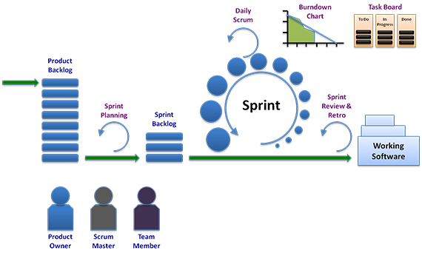

Slide 36
PBI=Product back lock Items
All requirement
High
Medium
Low
PO=Product owner responsible to tell PBI with ranking as High>medium>low
Break each PBI into Tasks / Items:
Task 1: Design related------Assign to One in desgin team
Task 2: Development related-------Assign to one Dev
Task 3: Data analysis-------------Assign to ETL
Task 4: Testing-----------------Assign to tester

Slide 37
Sprint= Time frame to complete certain PBI or requirement or Epic
Standard sprint 2 to 4 wks
Usually take 2/3 PBI in one sprint
How to select number/Story point of PBI=>
By poker play by Agile team member
Which PBI to be taken in sprint=> usually take High level PBI
By a meeting with
SM
PO/BA
All manager & Lead

Slide 38
Meeting in Sprint
Sprint planning- sprint start with this meeting
Sprint review/Retrospective meeting- sprint end with this meeting
If 2 wks sprint ::
Sprint planning- On Monday
Sprint review/Retrospective meeting- On Friday
Daily Scrum – every day 15 mints
Mid-sprint meeting – may or may not => middle of two wks

Slide 39
Agile framework
Kanban
Scrum, or
your own unique flavor

Slide 40
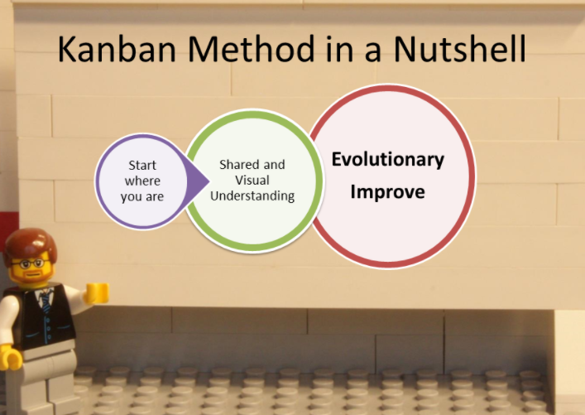

Slide 41
Kanban framework in Agile
Kanban : Japanese manufacturing system –TOYOTA: regulated through the use of an instruction card sent along the production line(1940).
Agile software development
same "just in time" (or JIT) principles by matching
the amount of work in progress (WIP) to the team's capacity.
Why Kanban?? gives teams more
flexible planning options,
faster output,
clearer focus, and
transparency throughout the development cycle.

Slide 42
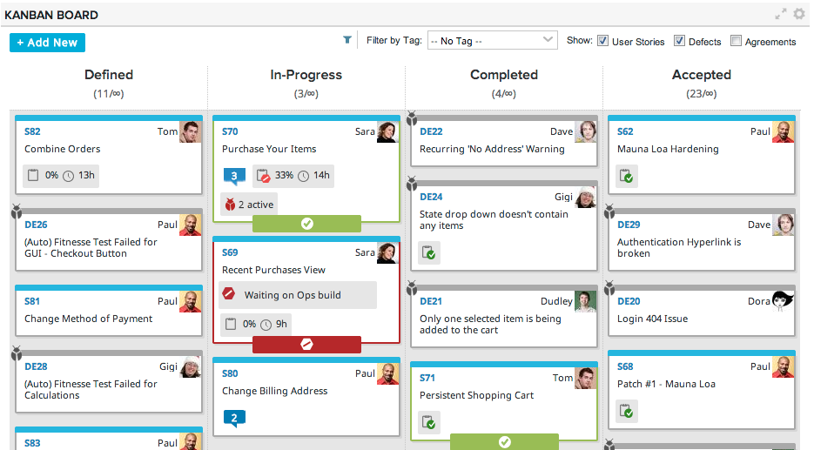
Kanban cards
In Japanese, kanban literally translates to "visual signal."
For kanban teams, every work item is represented as a separate card on the board.

Slide 43
Scrum framework in Agile
Scrum is a subset of Agile. It is a lightweight framework for building a software. Scrum begins when some stakeholders need a product.
Scrum is a team process.
Scrum is the most popular frameworks for agile.
So popular, in fact, that many people think scrum and agile are the same thing. (They're not.)
With scrum, the product is built in a series of fixed-length iterations called sprints that give teams a framework for shipping software on a regular cadence.

Slide 44
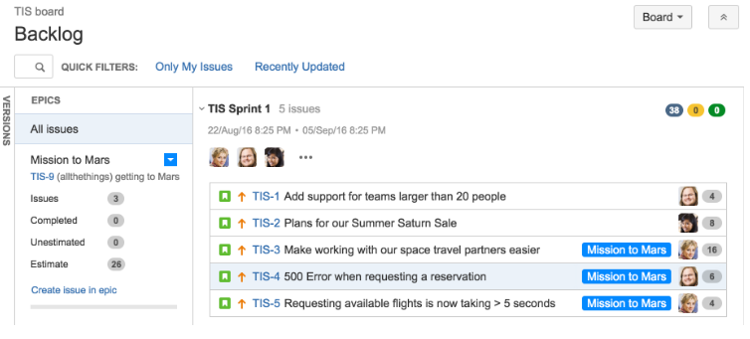

Slide 45
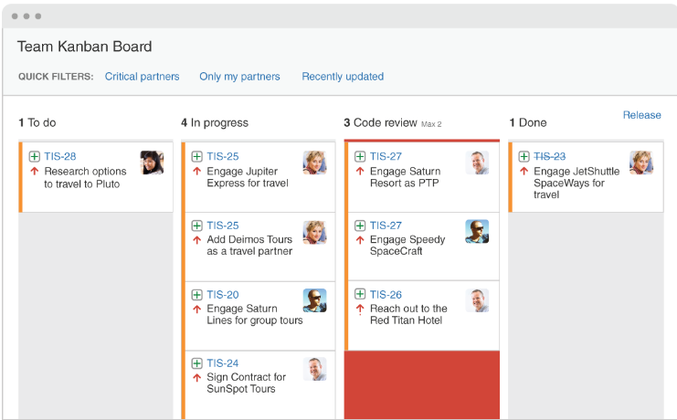

Slide 46
Scrum vs. Kanban
 | SCRUM | KANBAN
Cadence/sequence/time frame | Regular fixed length sprints (ie, 2 weeks) | Continuous flow
Release methodology | At the end of each sprint if approved by the product owner | Continuous delivery or at the team's discretion
Roles | Product owner, scrum master, development team | No existing roles. Some teams enlist the help of an agile coach.
Key metrics | Velocity | Cycle time
Change philosophy | Teams should strive to not make changes to the sprint forecast during the sprint. Doing so compromises learnings around estimation. | Change can happen at any time

Slide 47
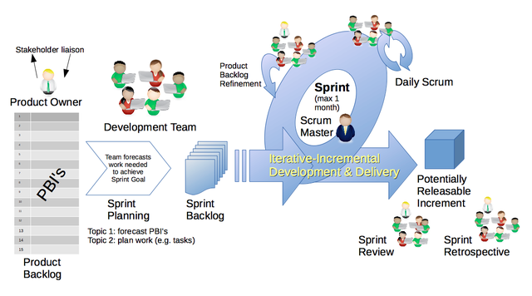

Slide 48
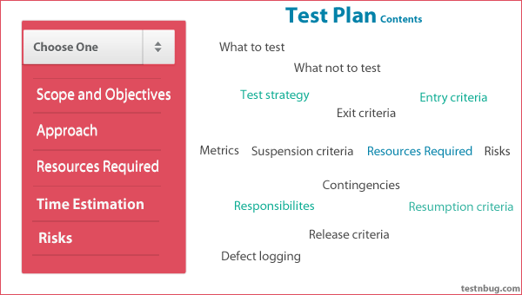
Test Plan

Slide 49
PBI | Sprint backlog | Roll over
All requirements in a project | Requirements/PBI: those taken in a sprint | Leftover work from one sprint to next sprint

Slide 50
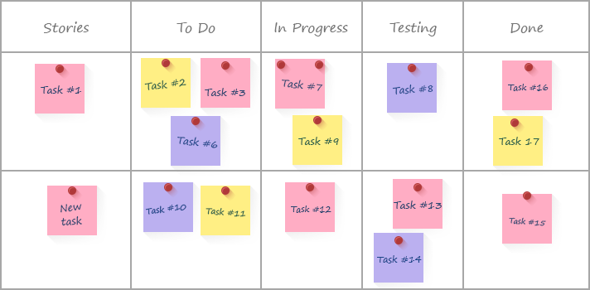
Time Estimation in Sprint
If 2 wk sprint:
Total 10 days:: 7 hrsx10=70 hrs
Estimate time for each PBI task or item by your self

Slide 51
How to measure productivity of team members working in Agile Scrum?
Burn down chart
Velocity matrix

Slide 52
Agile velocity
Velocity is a metric that predicts how much work an Agile software development team can successfully complete within a two-week sprint (or similar time-boxed period).
estimating how fast work can be completed and how long it will take to complete a project

Slide 53
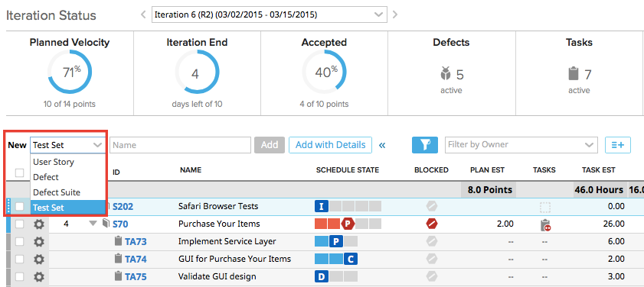

Slide 54
How to calculate Agile Velocity
The metric is calculated by reviewing work the team successfully completed during previous sprints;
for example, if the team completed 10 stories during a two-week sprint and each story was worth 3 story points,
then the team's velocity is 30 story points per sprint.

Slide 55
Velocity Tell when the project will finish
Generally, velocity remains somewhat constant during a development project, which makes it a useful metric for estimating how long it will take a team to complete a software development project.
If the product backlog has 300 story points, and
the team is averaging 30 story points per sprint,
it can be estimated that team members will require 10 more sprints to complete work.
If each sprint lasts two weeks, then the project will last 20 more weeks.

Slide 56
Burn Down Chart: A burn down chart is a graphical representation of work left to do versus time. The outstanding work (or backlog) is often on the vertical axis, with time along the horizontal. That is, it is a run chart of outstanding work. It is useful for predicting when all of the work will be completed.

Slide 57
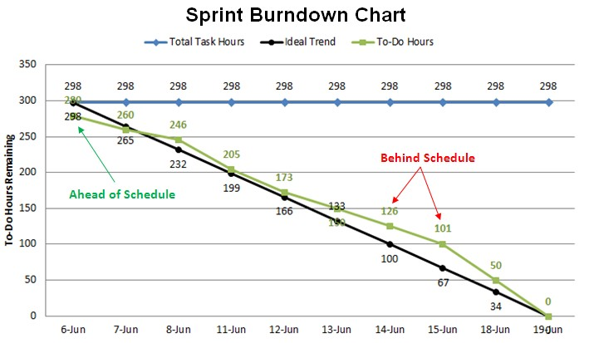
How to check Team status in Sprint:

Slide 58
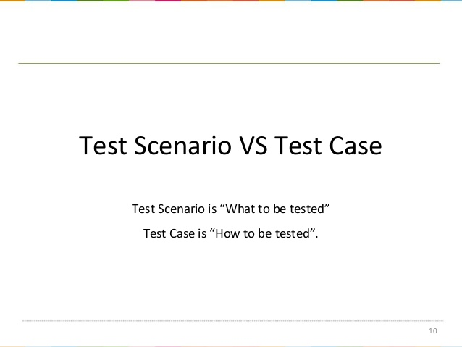
What is what??

Slide 59
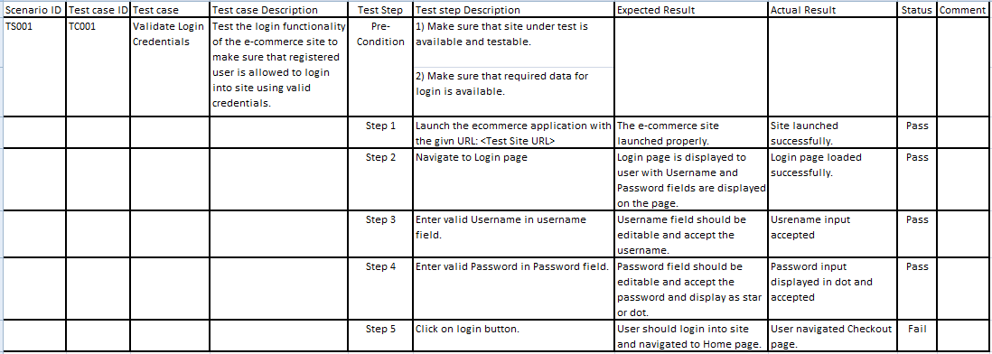
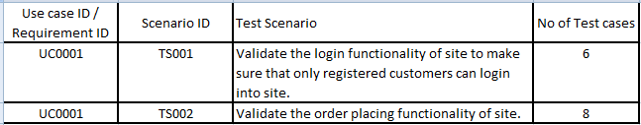

Slide 60
Test Suite/Regression Suite
Suite: Collection of test cases or test scenarios
Regression Suite: Collection of regression Test cases/regression scenarios
We run test suite or reg suite –
in every release
If any feature update
If any major defect or bug fixed

Slide 61
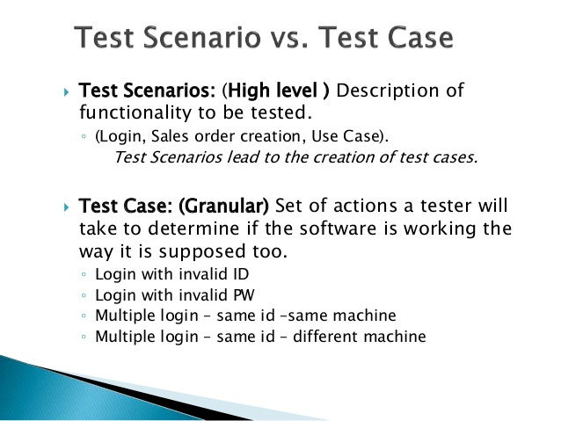
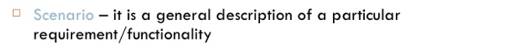

Slide 62
Test Case ID | Description | Expected Result | Actual Result | Status
TC001 | Open Browser | Browser open
 | Go https://www.facebook.com/ | Facebook login page appear
 | Put valid name in username field | name field should editable and accept name
 | Put valid password in password field | password field should editable and accept password
 | Click OB button | OK button should be Enable
 | Validate login status | Home page appear

Slide 63
How to write test case in BDD
BDD is behavior driven development
TDD is Test driven development
ATDD is acceptance test driven development
BDD focused on behavior or business logic or requirement

Slide 64
Test case in BDD known as Feature file:
A simple feature file consists of the following keywords/parts −
Feature − Name of the feature under test.
Description (optional) − Describe about feature under test/ requirement
Background: Any common Steps
Scenario − What is the test scenario.
Given − Pre-Action(open browser or put URL)
When − All Action(put user name & pass, OK button)
Then − After action or validation(Successfully enter home page)
And /or- Extra steps

Slide 65
Cucumber with BBD- Gherkin Language
Feature: Login Functionality Feature
Description:
In order to ensure Login Functionality works- want to run the cucumber test to verify it is working.
Password must be 8 char with one number and one symbol
Background: usually not use in normal scenario
Scenario: Validate Login Functionality
Given user able to open browser
And Navigate to application
When user logs in using <Username>
| Username |
|sarower|
And put <Password>
| Password |
|PASSWORD2$|
And Click OK Button
Then login should be successful

Slide 66
JIRA
Download from = https://www.atlassian.com/software/jira/try

Slide 67
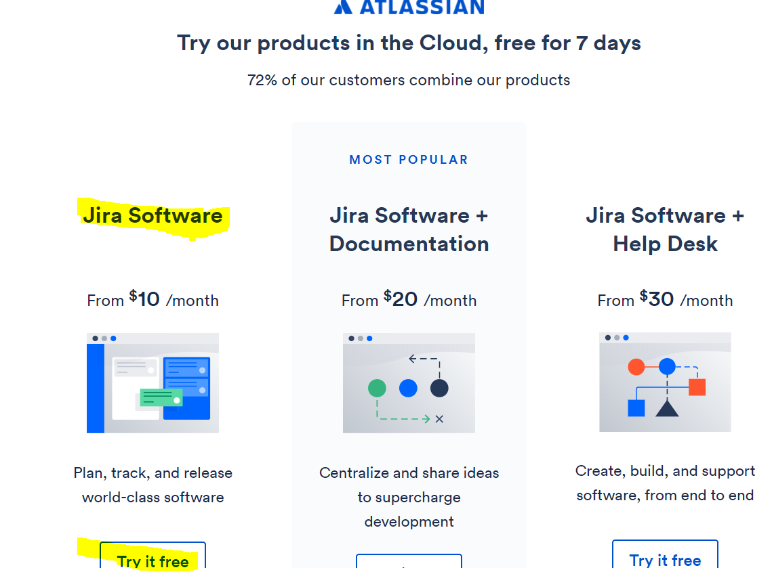

Slide 68
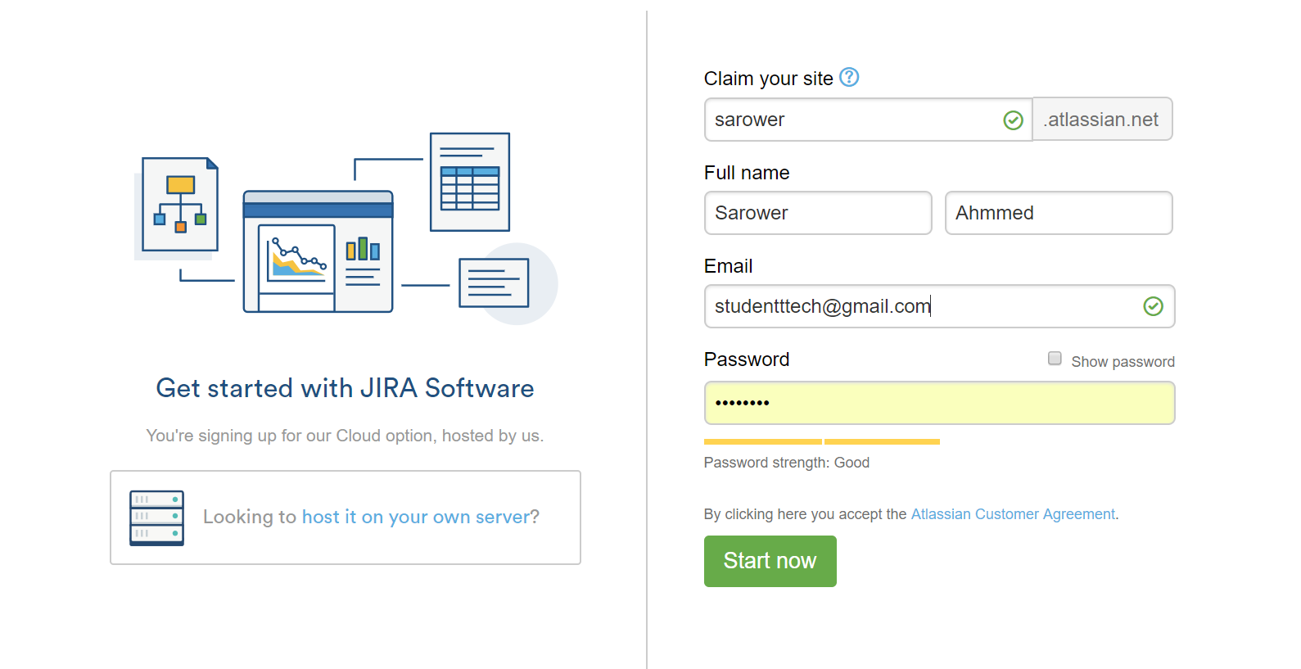

Slide 69
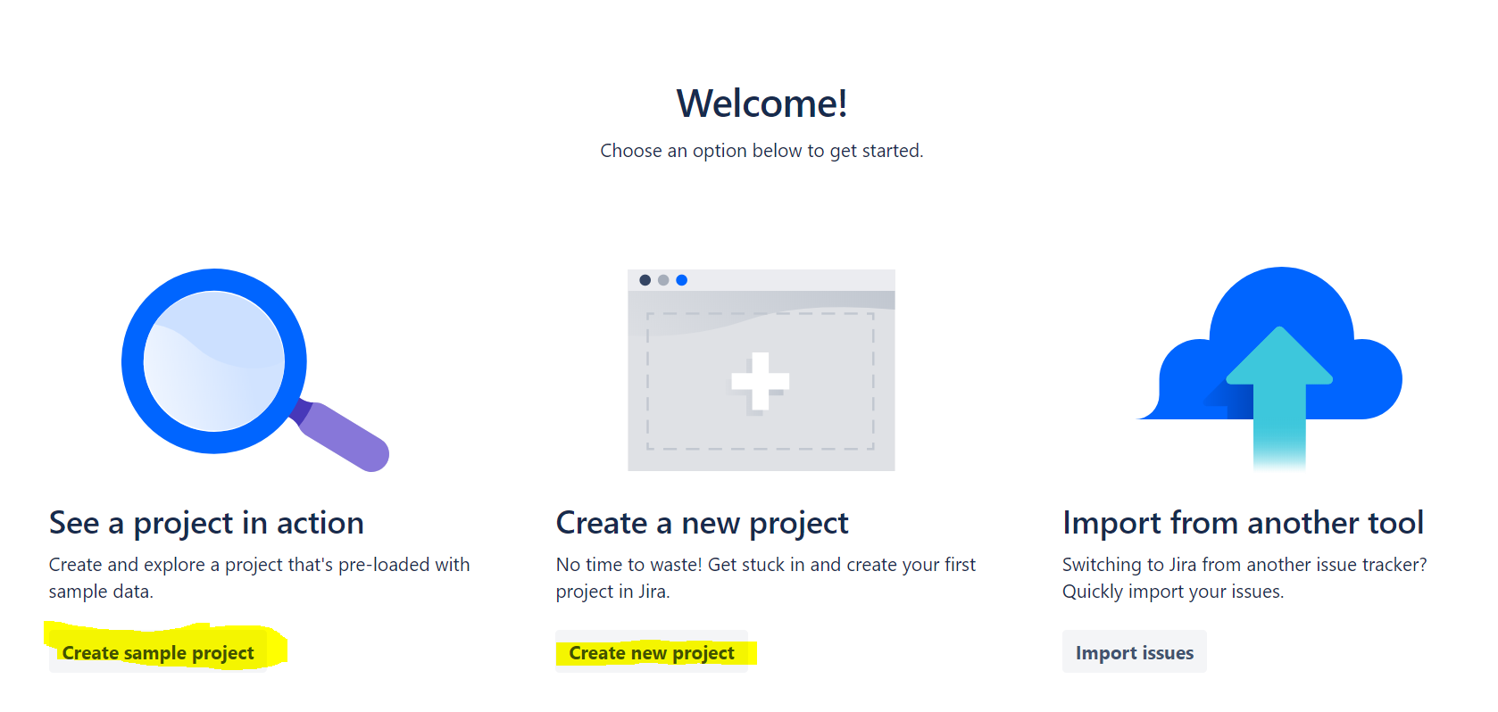

Slide 70
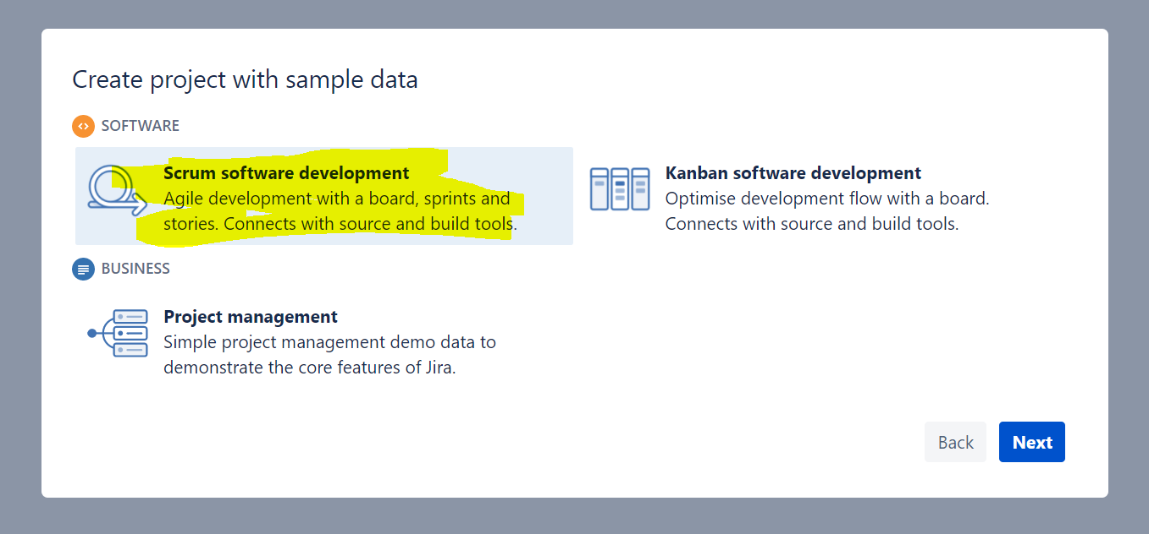

Slide 71
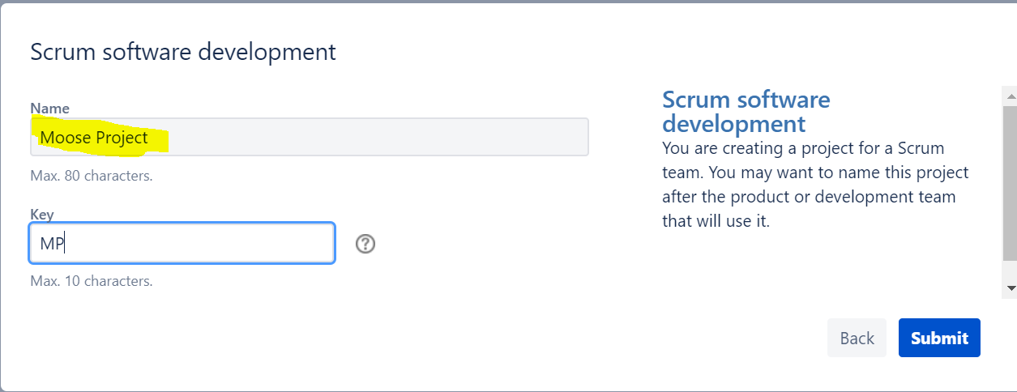

Slide 72
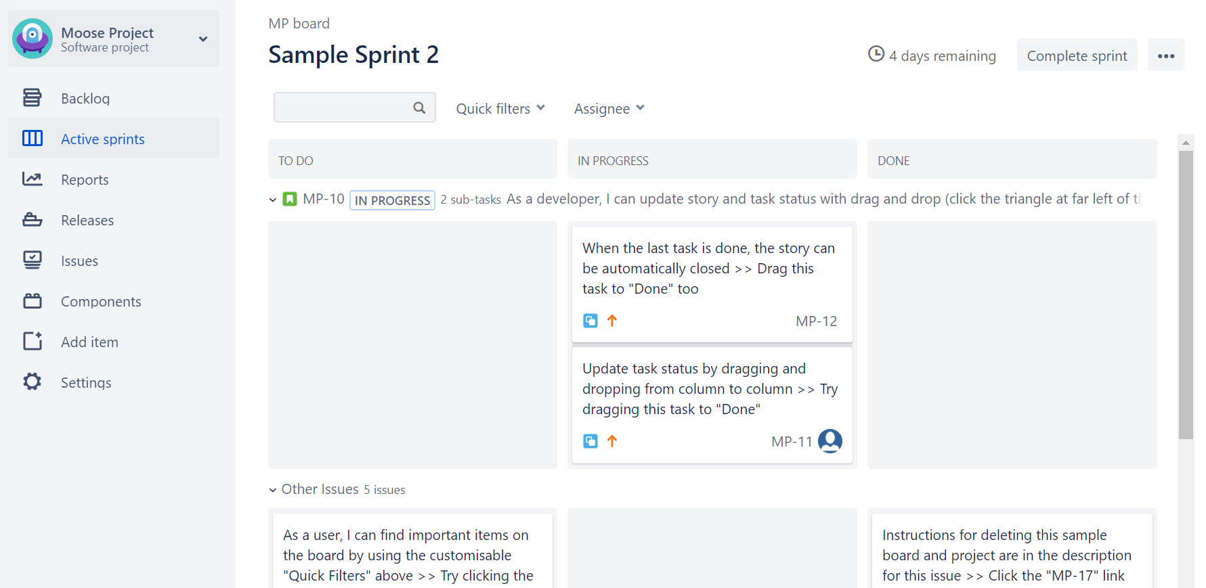
https://sarower.atlassian.net/secure/RapidBoard.jspa?rapidView=1&projectKey=MP

Slide 73
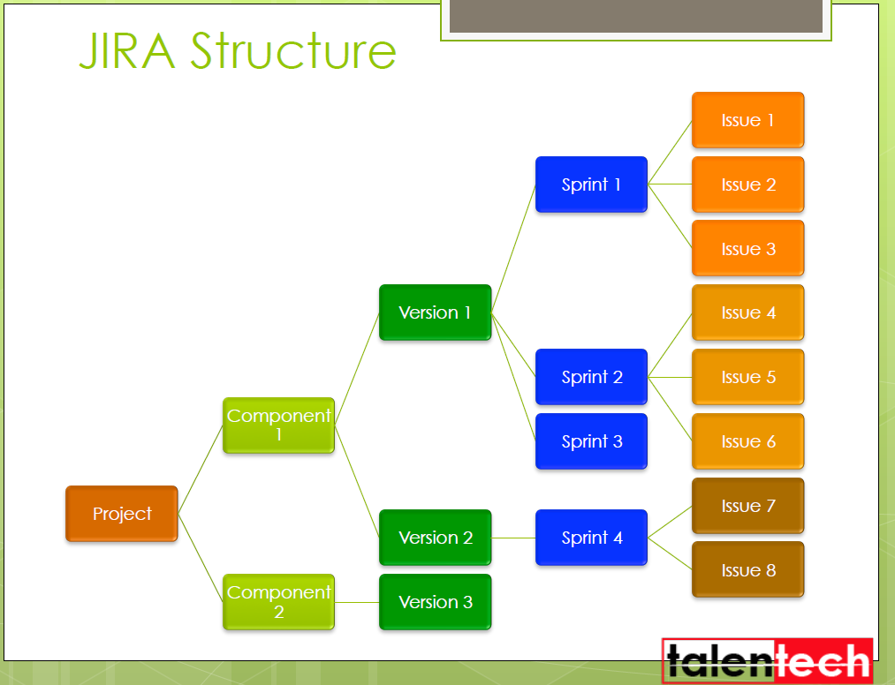

Slide 74
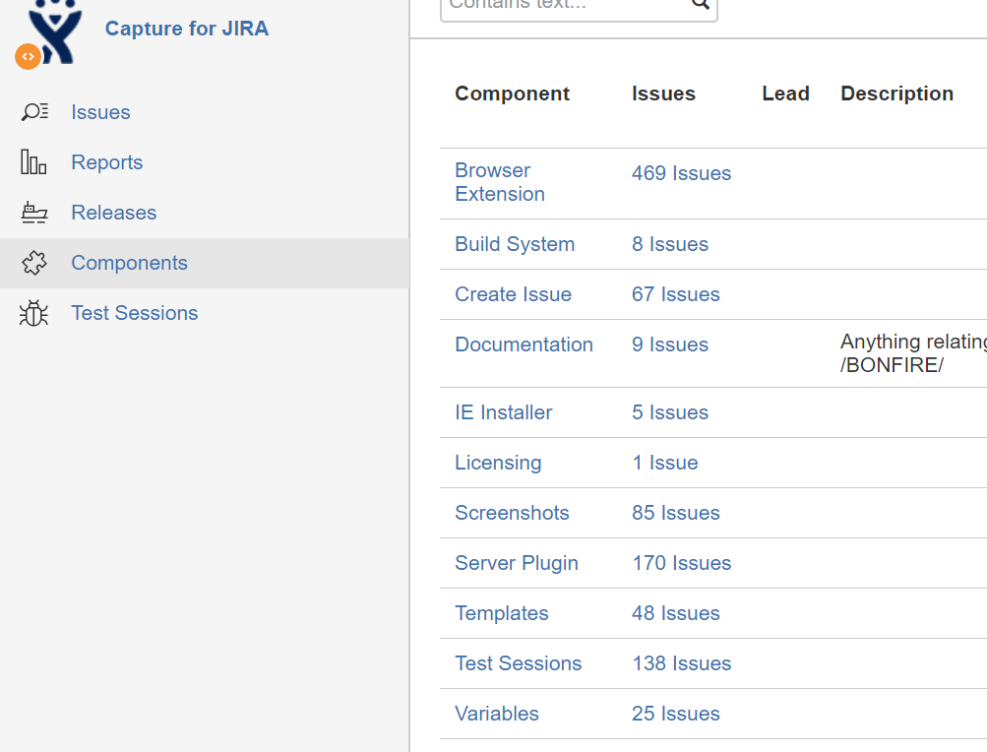
Component: divided project into small part

Slide 75
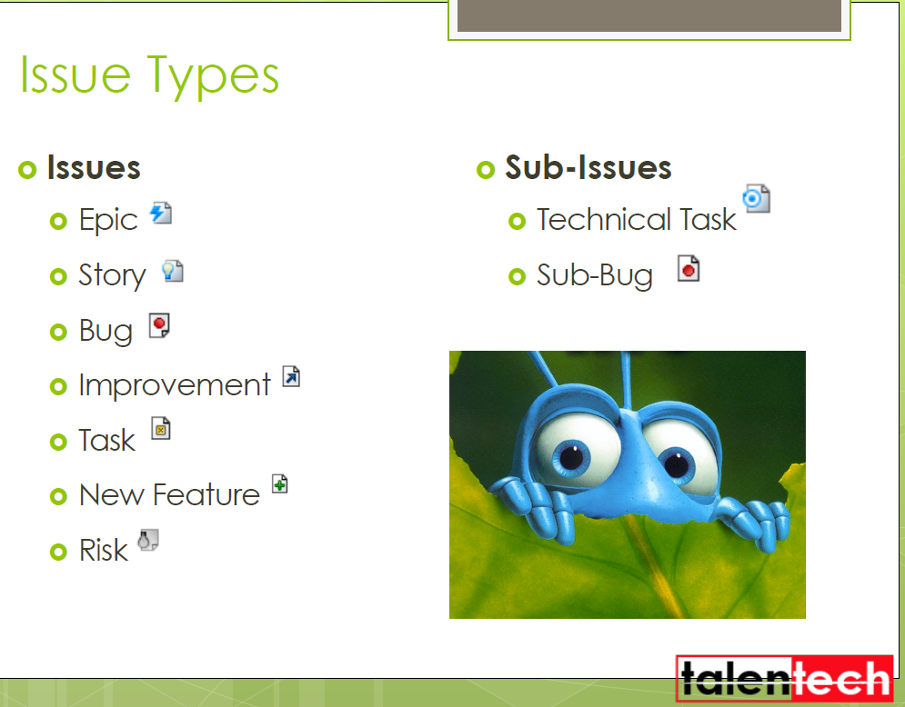

Slide 76
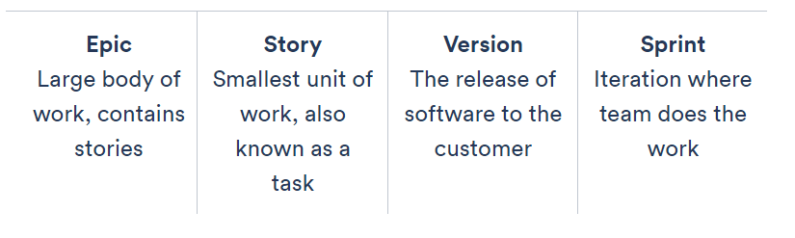
Epic>Story/task/item

Slide 77
Epic>Story/task/item…….version
Epics are larger bodies of work that stories roll up into more strategic goals or initiatives.
Can span across multiple sprints and versions.

Slide 78
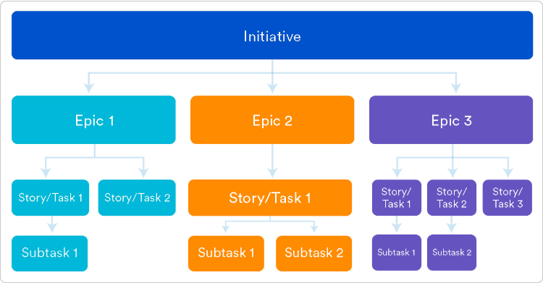
Epic vs Story

Slide 79
Example of an epic
Kanban:
epics can be used as swim lanes to segment different streams of work.
Scrum, epics can help label the work in your sprints,
like in the example below. Mission to Mars is an epic in this sprint. TIS 1, TIS 2, etc. are all user stories within the sprint (TIS Sprint 1).

Slide 80
What is a user story/story/task?
The user story describes the type of user,
what they want and
why.
A user story helps to create a simplified description of a requirement.

Slide 81
What is a version?-it’s a piece of product or functions
Versions are the actual releases of software out to customers.
Versions are often developed over a set of sprints, much like epics.
Example of a version
A product owner may structure the release strategy as follows:
Version 1: login, logout, password management
Version 2: purchase history
Version 3: saving preferences
etc.

Slide 82
How to use agile metrics to optimize your delivery in JIRA?
By Different JIRA Reports
Sprint Burndown
Epic and Release Burndown
Velocity
Control Chart
Cumulative Flow Diagram
Even more metrics!

